Slide 1


NSOP 2024
IPR #3
Air Force ROTC Detachment 842
The University of Texas at San Antonio
C/Llanas, C/Parry, & C/Griffin
22 JUL 24

Slide 2


Overview
Completed
To Be Completed
Updated NSOP Schedule
Leads/Representatives
Rooms (Reserved)
Logistics
Summary
Air Force ROTC Detachment 842 • We Build Exceptional Officers • The University of Texas at San Antonio

Slide 3
Completed
Emails:
Sports Physical
Pre-NSOP Survey
NSOP UOD
NSOP Requirements (Money/Documents)
Official NSOP Information/Parking
Slack Invitational
Week 1 Overview (PT/ASC/LLAB)
Week 1 Uniform Wear
Nurse Email
https://docs.google.com/document/d/11txzHoihzxcjbwZwMkWkOpm_2w-qzHo6BAZM3v5fs_4/edit?usp=sharing
Spreadsheets:
Cadet Check-In
Height & Weight
Required Links
Other:
Pre-NSOP Survey
NSOP Recruits Slack Channel
https://docs.google.com/spreadsheets/d/1BkQEMqKG_T3epj1OcjSrjRGNNHdC_P1sLhtoB4Zuykc/edit?usp=sharing
Air Force ROTC Detachment 842 • We Build Exceptional Officers • The University of Texas at San Antonio

Slide 4
To Be Completed
Volunteers (Name, Phone Numbers, Availability, & Laptops) NLT 8 Aug 24
Cadets assigned to flights A-D & W-Z
GLPs (3) for FCs NLT 9 Aug 24
Logistics Spreadsheet
Air Force ROTC Detachment 842 • We Build Exceptional Officers • The University of Texas at San Antonio

Slide 5
Updated NSOP Date & Time
Aug 22nd – Main Auditorium (Cadre Led):
0700 – 0755: Leads/Volunteers Arrive for set-up
0800 – 0915: Check-in/In-Process
0920 – 0955: Commander's Intent/Questions
1000 – 1200: Cadre Introductions/Paperwork/WINGS Breakdown
1200 – 1300: Leads/Volunteers Clean up
Aug 23rd – Main Auditorium (Wing Led):
0700 – 0755: Leads/Volunteers Arrive for set-up
0800 – 0900: Check-in at Main Auditorium
0900 – 0915: Break into Groups/Flights
0915 – 1100: Rotate to different Rooms for LRS, Physicals, and Tours
1100 – 1200: Main Auditorium round up for Club Briefings (8 min. max), and Cadet A-Staff introductions
Prospects Dismissed
1200 – 1300: Leads/Volunteers Clean up
Air Force ROTC Detachment 842 • We Build Exceptional Officers • The University of Texas at San Antonio

Slide 6
Leads/Representatives
About 9 Leads
C/Llanas:
Check-in
Height/Weight
LRS
C/Griffin:
Ushers
Tour Guides
Physicals
C/Parry:
Guides
Runners
23 August 24 (Friday) Speakers
A-Staff Representative(s))
Booster
AAS
Honor Guard
Victory
I5
Air Force ROTC Detachment 842 • We Build Exceptional Officers • The University of Texas at San Antonio

Slide 7
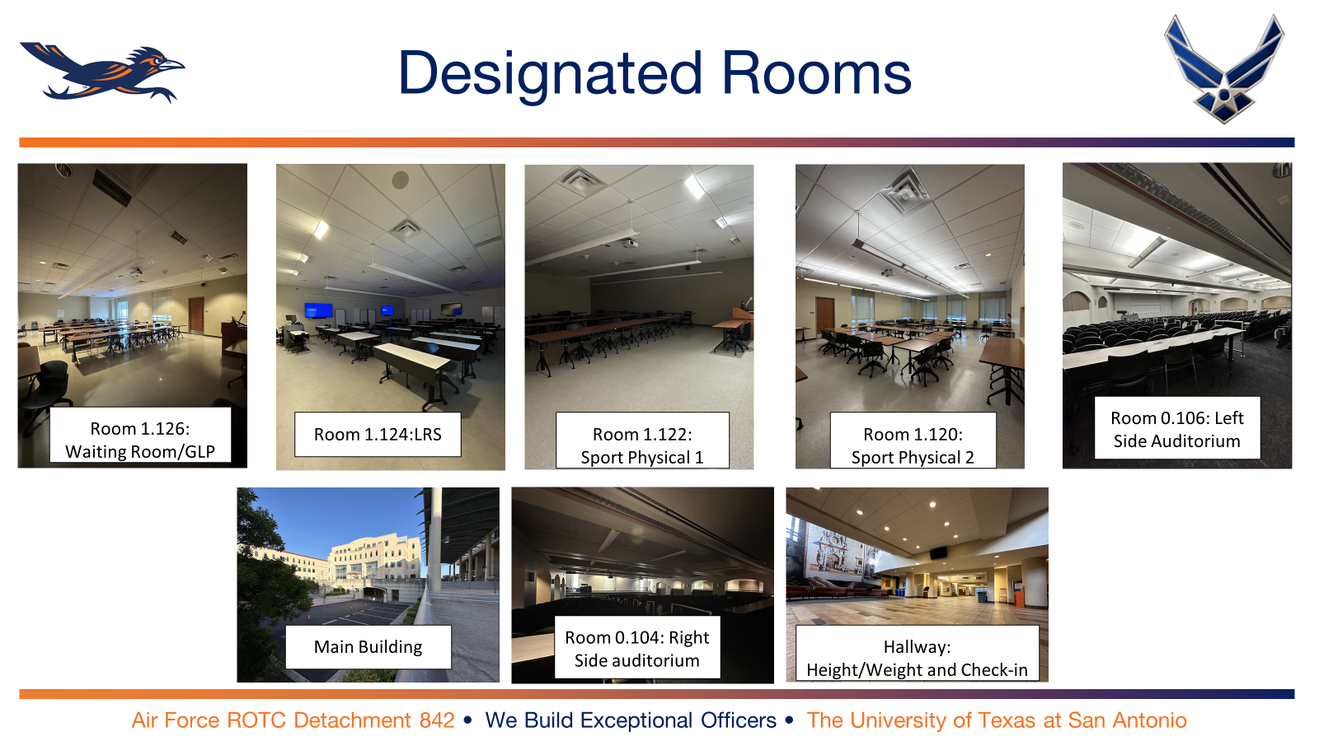
Rooms to Reserve

Slide 8
Logistics
Thursday:
Tables 🗸
Chairs 🗸
Directional Signs
Extra Paperwork
Writing utensils
Laptops 🗸
Printer 🗸
Waters/Cooler 🗸
Friday:
Height/Weight equipment 🗸
Uniforms (Polos/Det PT Shirts)
Directional Signs
Tables 🗸
Chairs 🗸
Laptops 🗸
Extra Copies (Physicals, GLPs)
Waters/Cooler 🗸
First Aid
Colored wrist bands 🗸
Air Force ROTC Detachment 842 • We Build Exceptional Officers • The University of Texas at San Antonio

Slide 9
Summary
Completed
To Be Completed
Updated NSOP Schedule
Leads/Representatives
Rooms (Reserved)
Logistics
Summary
Air Force ROTC Detachment 842 • We Build Exceptional Officers • The University of Texas at San Antonio

Slide 10
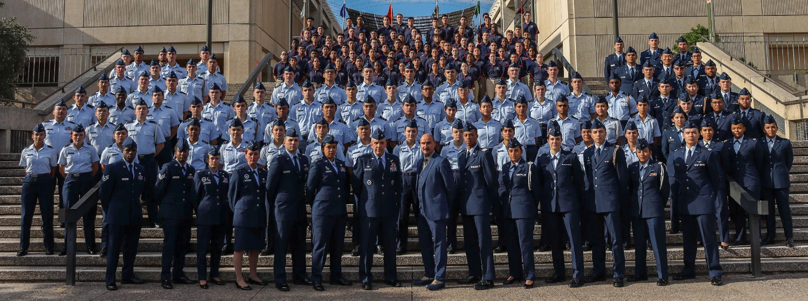
Air Force ROTC Detachment 842
The University of Texas at San Antonio
Det 842 – Best in Blue

